Slide 1
Basic Queries
C393: Database Systems

Slide 2
Review

Slide 3
Lesson Objectives
Use SELECT statements to retrieve specific data from a database

Slide 4
Data Manipulation

Slide 5
Follow Along
Download and run cartoon_equipment_database.sql
Create a new notebook or script and run commands as we go.

Slide 6
The SHOW Statement
Query information about databases, tables, columns, users, and privileges
SHOW DATABASES;
SHOW TABLES FROM DB;
SHOW COLUMNS FROM DB.table;
SHOW CREATE DATABASE DB;
SHOW CREATE TABLE DB.table;
SHOW STATUS;
SHOW GRANTS;
SHOW ERRORS;
SHOW WARNINGS;
Notes:
Suppose we found our way onto a database server; how can we learn about what is on it?
Terminology
Class -> Table
Attributes -> Columns
SHOW statement allows us to learn about what is on the DB server
All the databases on the server (some are in the SCHEMA window, some are not)
Tables from a specific database
Columns from a specific table (cartoon_equipment.customers)
Display statements that create specific things (Database, Table)
Display status of the server
Display privileges and roles that are assigned to a MySQL user account or role
Diagnostic statements relating to errors and warnings for the current context
We are hackers. We just infiltrated a DMBS server. What are some of the first things we might want to do?
SHOW allows us to see all databases on the server and the schemas for those databases
SHOW databases;
SHOW tables from cartoon_equipment
SHOW columns from cartoon_equipment.customers;
(Do at least 'SHOW DATABASES' and 'SHOW TABLES FROM cartoon_equipment;' in workbench)

Slide 7
The USE Statement
Select a database
Requires name of an existing database
USE cartoon_equipment;
Notes:
We have seen there may be many databases on the server
Before we start to query a database; we need to tell MySQL which database we want to use
Not completely necessary, but simplifies things:
Select * from customers vs
Select* from cartoon_equipment.customers
Before querying a database you must select a database to use
What results does the USE statement produce? – No results

Slide 8
The SELECT Statement
Query table data
Requires column(s) to select and table(s) to select from
Note that columns may be computed
Use the DISTINCT keyword to choose only unique row/column values
Use the AS keyword to rename columns
Quote using backticks (`) when necessary or quotes
SELECT * FROM vendors;
SELECT prod_id, prod_name, prod_price FROM products;
SELECT DISTINCT vend_id FROM products;
SELECT DISTINCT vend_id AS `Vendor ID` FROM products;
Notes:
SELECT statements allows us to query data FROM the tables in the database
SELECT must have a FROM
Can use DISTINCT to not get duplicates
Rename columns using AS
If we include two or more tables in FROM, then a Cartesian product of those tables are formed.

Slide 9
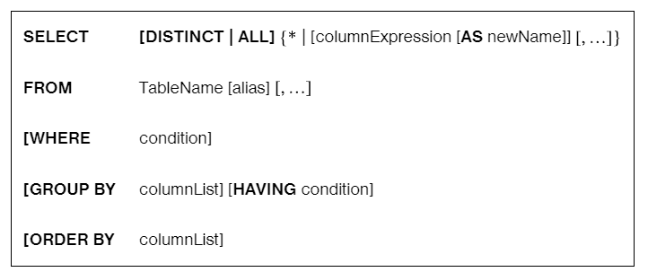
SELECT syntax
Notes:
Must be in this order

Slide 10
The ORDER BY Clause
Specify column(s) by which to sort the results
Requires column(s) on which to order
Use the DESC keyword to sort in descending order
SELECT * FROM vendors ORDER BY vend_name;
SELECT prod_id, prod_name, prod_price FROM products ORDER BY prod_id DESC;
Notes:
ORDER BY allows us to sort on specific columns
Default is ascending; use DESC for descending order

Slide 11
The WHERE Clause
SELECT * FROM vendors WHERE vend_country = "USA";
SELECT * FROM products WHERE prod_name IS NULL;
Filter output by the specified search criteria
Requires column(s) to search and filter condition(s) to match
By default, Windows MySQL is not case-sensitive
By default, Unix-based MySQL is case-sensitive
Use the IS NULL clause to match absent data
NULL values are neither equal nor non-equal to any value
Notes:
So far we have been showing everything in certain tables (or specific tables)
What if we are looking for something specific?
The WHERE clause enables us to filter output
Requires columns to search
And a Boolean expression that evaluates to TRUE or FALSE
MySQL is not case sensitive by default
Use IS NULL / IS NOT NULL instead of = NULL / = NOT NULL
Note WHERE comes before ORDER BY in the SELECT statement

Slide 12
WHERE Clause Operators
Operator | Meaning
= | Equals
<> | Does not equal
!= | Does not equal
< | Is less than
<= | Is less than or equal to
> | Is greater than
>= | Is greater than or equal to
BETWEEN A AND B | Is between given values
SELECT * FROM products WHERE prod_price <= 100;
SELECT * FROM products WHERE prod_price BETWEEN 5 AND 10;
Notes:
Many of these are similar to Python, but note equality is one equal sign

Slide 13
The AND And OR Keywords
Combine WHERE clauses using boolean operators
Require two WHERE clauses to combine
AND comes before OR in order of operations
You can use parentheses to help group
SELECT * FROM products WHERE vend_id = 1003 AND prod_price < 10;
SELECT * FROM products WHERE vend_id = 1003 OR prod_price < 10;
Notes:
WHERE can use a combination of relational and logical operators
Logical (keyword) operators used to combine two WHERE clauses
Similar to a complex Boolean expression in Python
Just like Python AND has precedence over OR in order of operations

Slide 14
The IN And NOT Keywords
SELECT * FROM products WHERE vend_id IN (1002, 1003);
SELECT * FROM products WHERE vend_id NOT IN (1002, 1003);
Specify a range of conditions
Requires a comma-delimited list of values within parentheses
Negate with the NOT keyword
Notes:
IN allows us to test set membership
The set used with IN can be hardcoded or the result of a SELECT statement

Slide 15
The LIKE Operator
Filter output by specified search criteria, including wildcards
% wildcard matches 0 to many characters
_ wildcard matches exactly one character for every _
SELECT * FROM products WHERE prod_name LIKE 'jet%';
SELECT * FROM products WHERE prod_name LIKE '_ ton anvil';
Notes:
Use the LIKE operator to perform string pattern matching
% is a wildcard; can be used before or after or both; 0 to many characters
_ is a wildcard that matches one character for every underscore

Slide 16
The LIMIT & OFFSET Clauses
Specify a maximum number of rows to return
Requires a number (the limit)
Specify which record to start from with OFFSET
SELECT vend_name FROM vendors LIMIT 1;
SELECT vend_name FROM vendors OFFSET 3;
SELECT vend_name FROM vendors LIMIT 3 OFFSET 3;
Notes:
SELECT and FROM are mandatory
There are many optional clauses
Use LIMIT to get no more than specified number of rows
Why might you did this?
Perhaps just testing things out
Once we order, maybe want top 1,2,3 records

Slide 17
In Class Exercise
Download and run the film_full.sql database.
Answer the following questions:
SELECT FROM WHERE ORDER BY LIMIT OFFSET

Slide 18
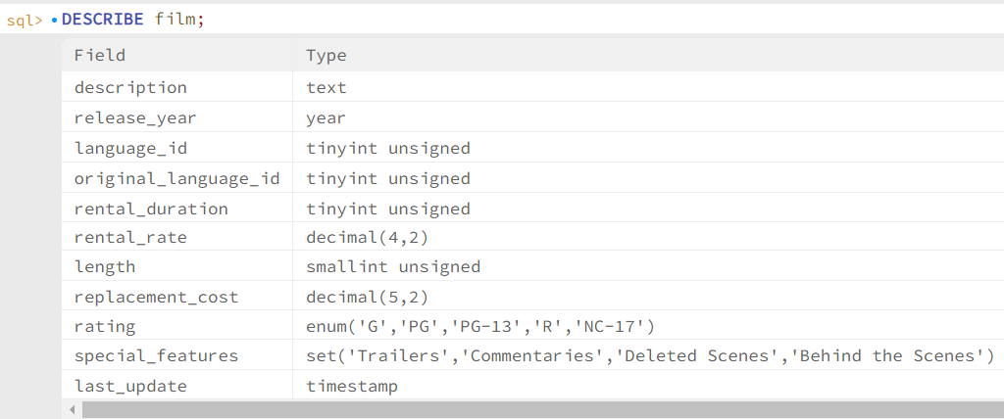
In Class Exercise
Display the first ten films, only show the title, release year, and rating
Display the longest ten films, show the title, release year, and length.
Display the movies who are between the 20th and 30th longest movies.
SELECT FROM WHERE ORDER BY LIMIT OFFSET

Slide 19
In Class Exercise
Display films that have a length of 50 or less.
Display films that are rated R and have a rental duration of 7 or more
Display R or NC-17 -rated films where the replacement cost is less than the rate times duration
SELECT FROM WHERE ORDER BY LIMIT OFFSET

Slide 20
In Class Exercise
Display films that start with the word CAUSE
Display films that end with the word CAUSE
Display films that have CAUSE anywhere in the title
SELECT FROM WHERE ORDER BY LIMIT OFFSET

Slide 21
In Class Exercise
Display all release years present in the film table (no duplicates).
SELECT FROM WHERE ORDER BY LIMIT OFFSET

Slide 22
Derived Attributes

Slide 23

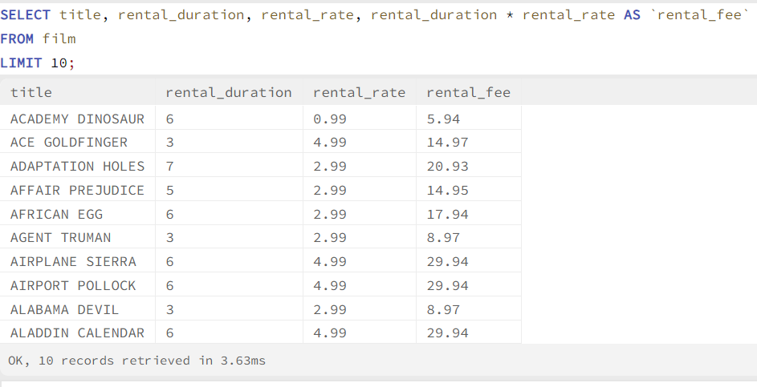
Derived Attributes
Derived attributes are calculated on the spot by the database engine
Use AS keyword to name them
Can also be used in queries (as seen above)

Slide 24
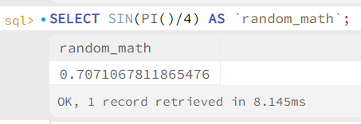
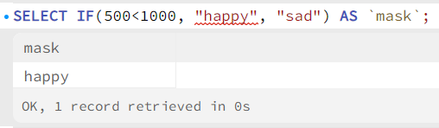
Functions
SQL provides many functions that can be used in derived attributes and criteria
MySQL Functions (w3schools.com)

Slide 25
In Class Exercise
Use functions to determine if a movie is PG rated or not (don’t use an OR criteria)
Convert the length (in minutes) to time in hours + minutes: 125 becomes 2 hr. 5 min.
CONCAT and MOD will be your friends.
SELECT FROM WHERE ORDER BY LIMIT OFFSET

